Slide 1
BOM

Slide 2


1.Window Object

Slide 3
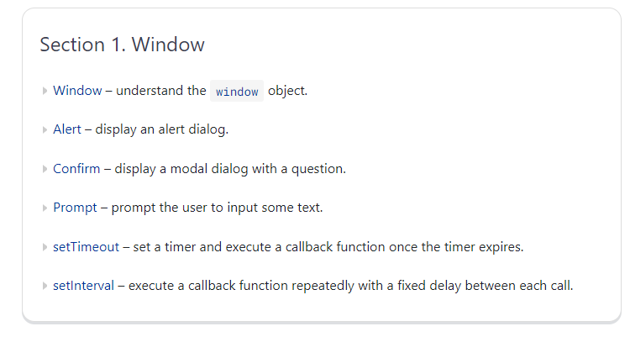
BOM

Slide 4
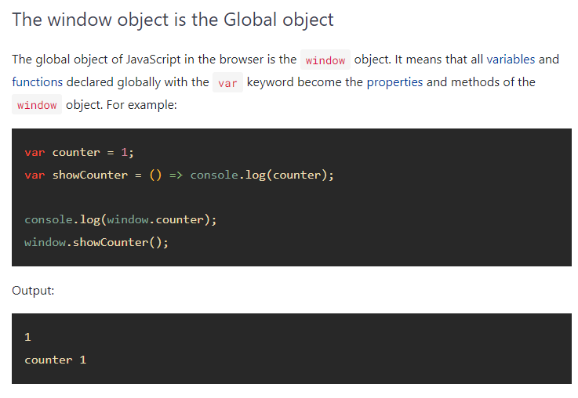
Window Object

Slide 5
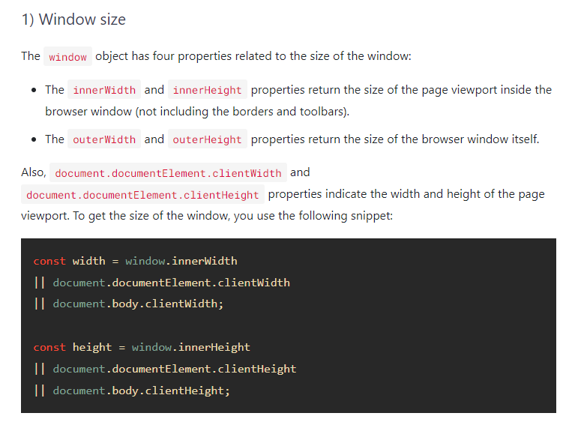

Slide 6
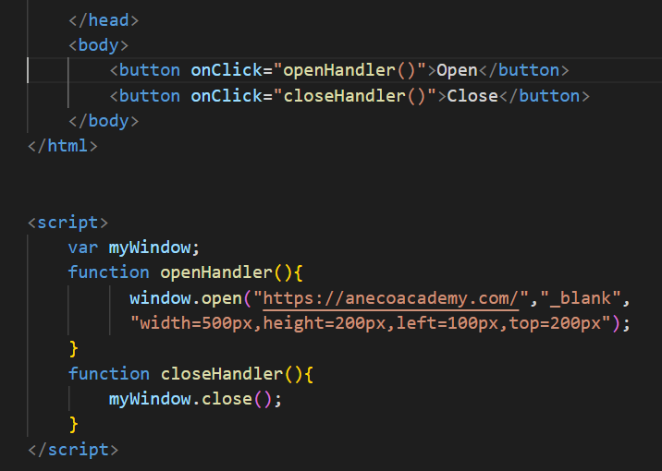
window.open And window.close

Slide 7
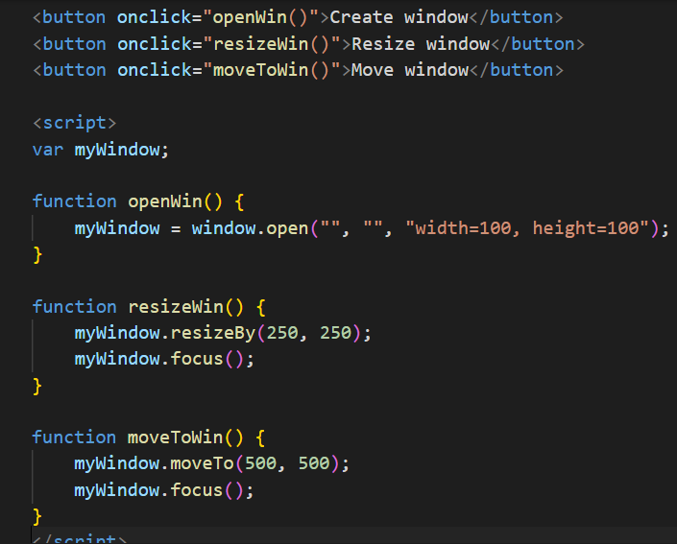
Window.resizeBy and window.moveTo

Slide 8
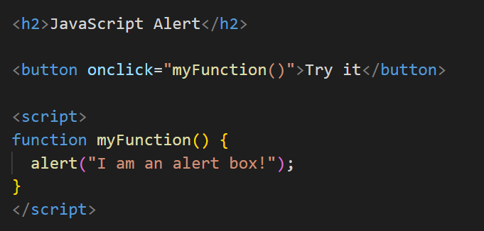
alert

Slide 9
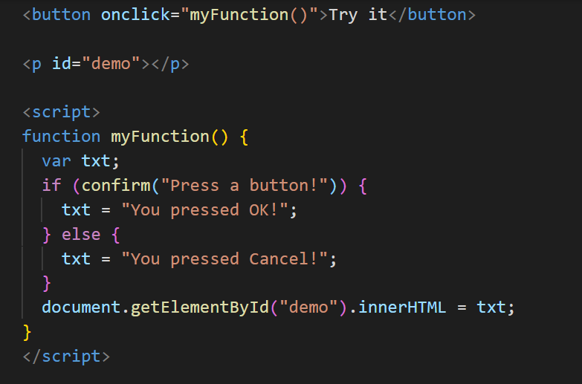
confirm

Slide 10
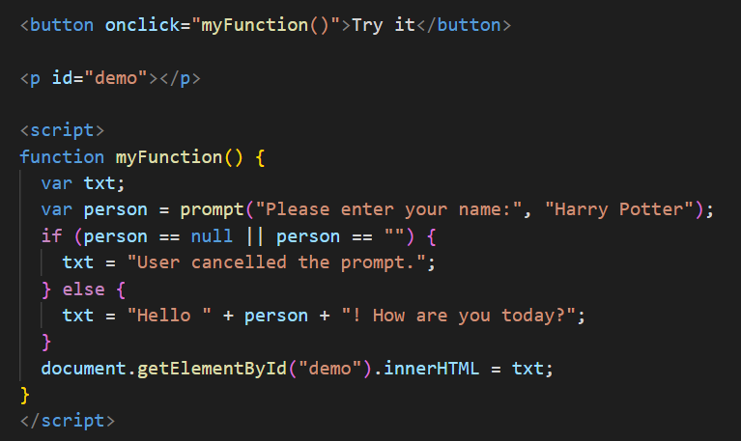
prompt

Slide 11
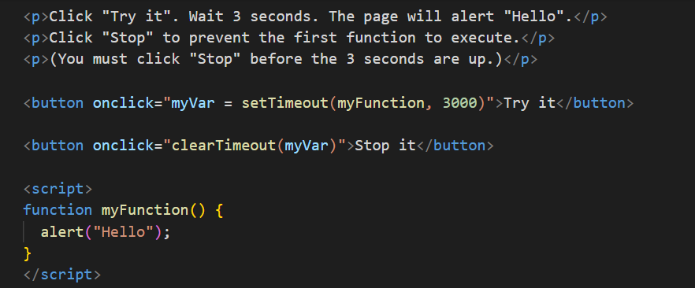
setTimeout

Slide 12
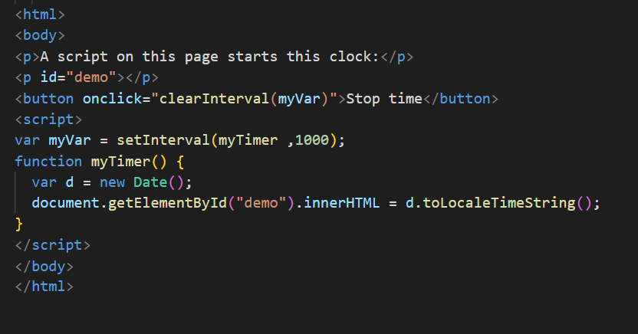
setInterval

Slide 13
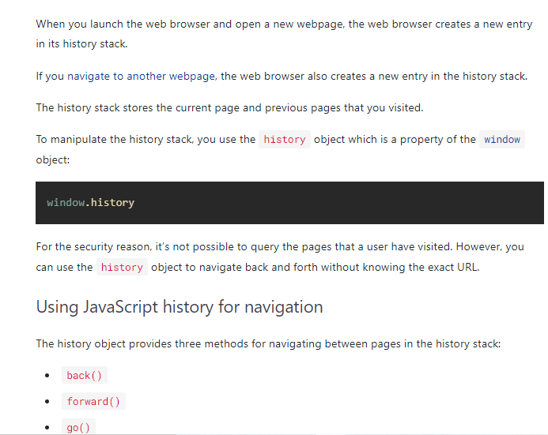
2. Window.history

Slide 14
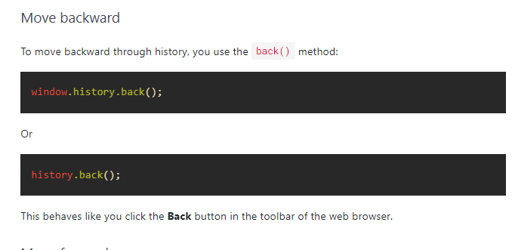
Move Backward

Slide 15

Move Forward

Slide 16
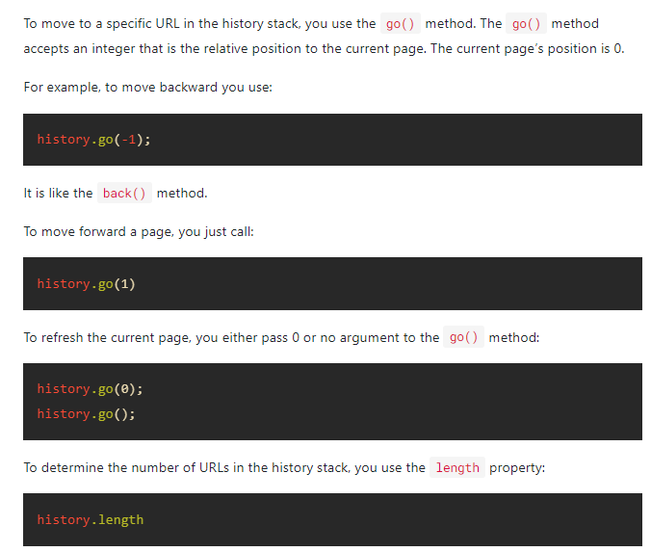
URL History

Slide 17
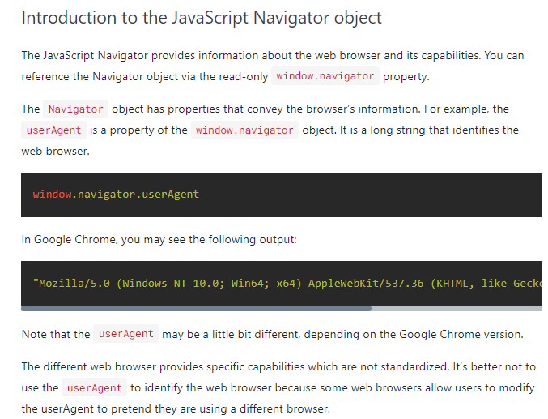
3. Window.navigator

Slide 18
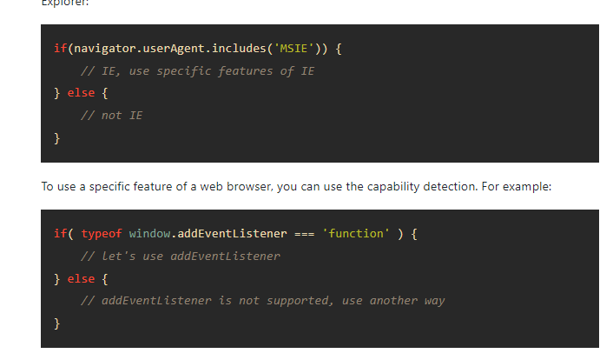

Slide 19
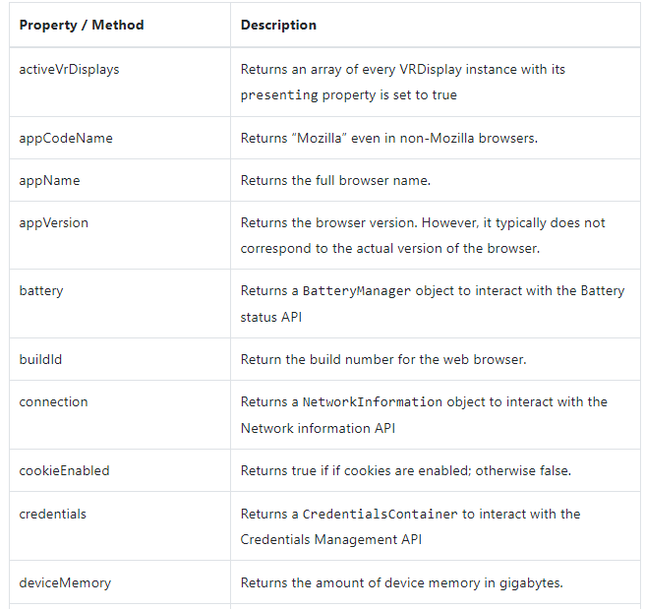
JavaScript Navigator Properties & Methods

Slide 20
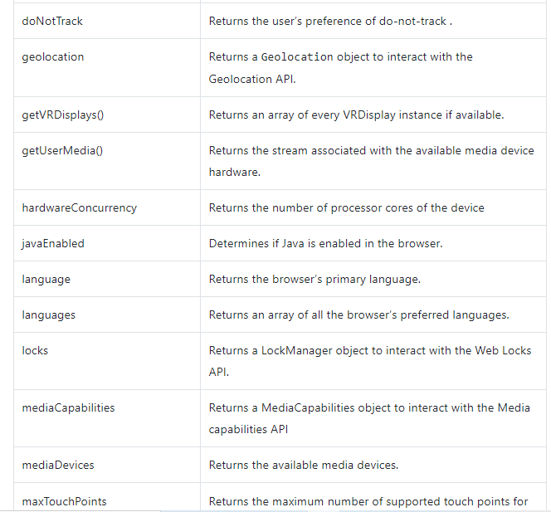
JavaScript Navigator Properties & Methods

Slide 21
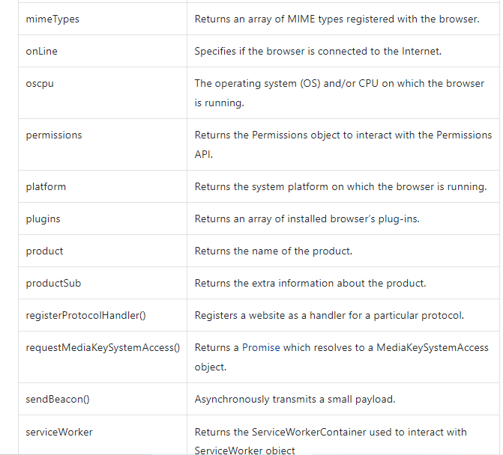
JavaScript Navigator Properties & Methods

Slide 22
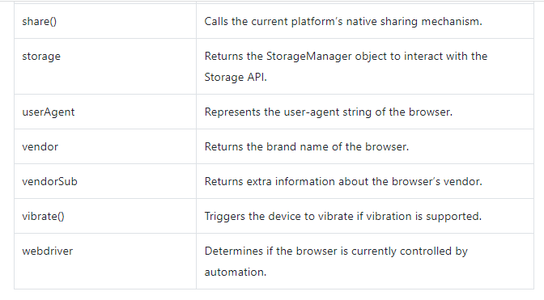
JavaScript Navigator Properties & Methods

